Slide 1


Social Buzz Insights

Slide 2


Today's agenda
Project recap
Problem
The Analytics team
Process
Insights
Summary

Slide 3


Our Client Social Buzz is a big social media conglomerate company
wants to oversee their scaling process effectively thus they are
expecting the following:
1.Audit for Big Data Practices
2.Recommendations for IPO
3.Analaysis for their content categories
So we as an analytics team focused on their companies data
and from the data we are providing the valuable insights.
Project Recap

Slide 4


Problem
More than 100,000 pieces of content
Want to analyze the content categories based on popularity
Don’t know how to scale their Company effectively

Slide 5


Andrew Fleming
The Analytics team
Marcus Crompton
Lokesh A

Slide 6

Process
1
Data Extraction and Understanding
2
Data Cleaning
3
Data Manipulation Using Sql
4
Data Analysis
5
Insights From Data

Slide 7
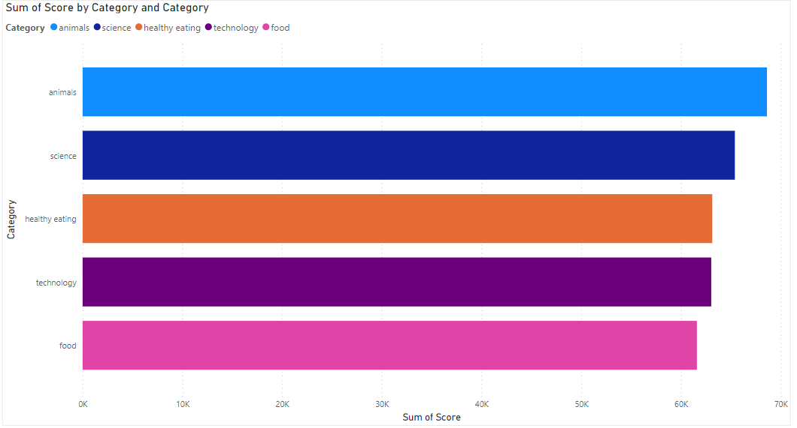

Insights

Slide 8
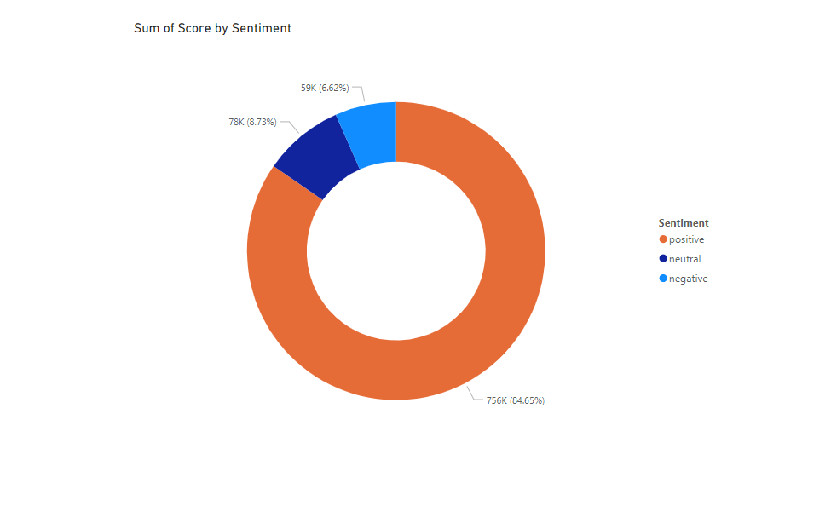

Slide 9
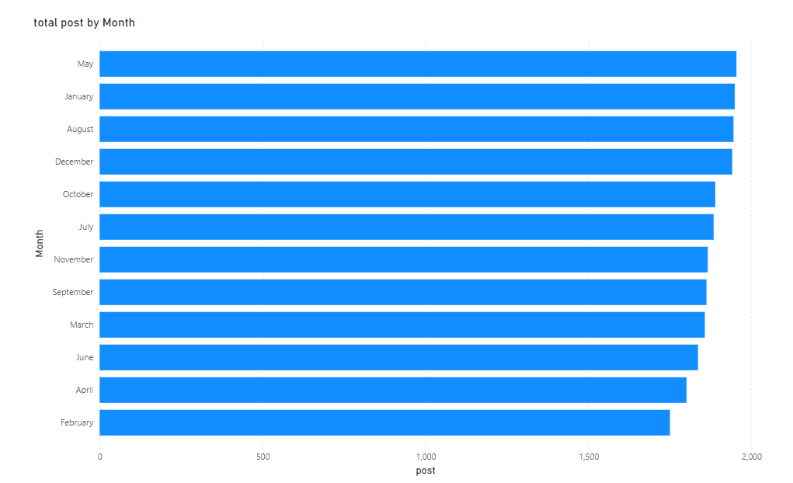

Slide 10
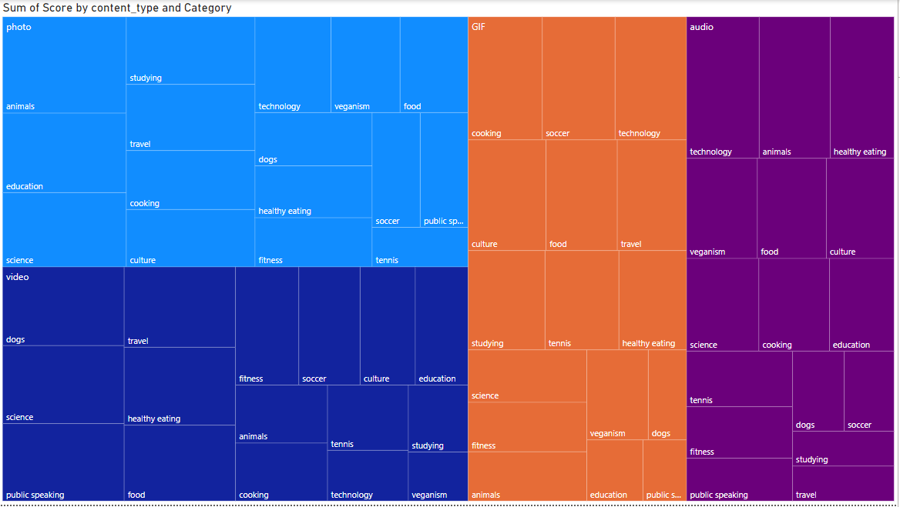

Slide 11
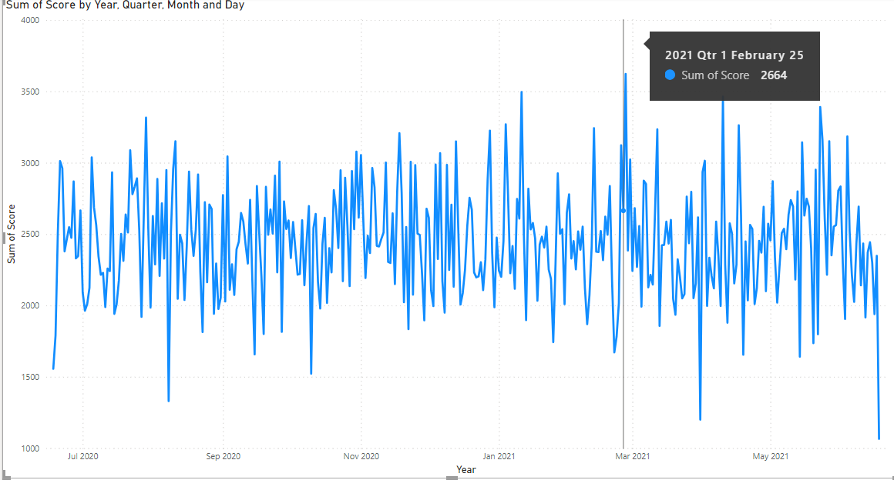

Slide 12


Animal, Science, Health Eating, Technology, Food are the most scored Category Among Users
Summary
Most of the User Have reacted to the post in a positive way followed by Neutral and negative comments so users are spreading love in the social buzz content means people are happy and enjoying the content
Most of the photos are related to animals, most of the videos are related to dogs most of the gifs are related to cooking and most of the audios are related to technology

Slide 13

Thank you!
ANY QUESTIONS?

